Slide 1
Aeroelastic Simulation Of Wind Turbines Using Free Vortex Methods And Strategies For Accelerating The Computation
A Doctoral Dissertation Proposal
Shujian Liu
The University Of Massachusetts Amherst Wind Energy Center
Department of Mechanical and Industrial Engineering
March 9, 2017

Slide 2
Acknowledgements
Dissertation Committee
Dr. Matthew A. Lackner
Dr. James F. Manwell
Dr. Hans Johnston
University of Massachusetts
Department of Mechanical Engineering
Wind Energy Center
MGHPCC
NREL

Slide 3
Outline
Background
Offshore Floating Wind Turbine
Aerodynamic Models
Free Vortex Method
WInDS
Acceleration of WInDS
Coupling WInDS with FAST/AeroDyn
Compiling on MGPHCC
Results
Near-Term Goals
Concluding Remarks

Slide 4
Outline
Background
Offshore Floating Wind Turbine
Aerodynamic Models
Free Vortex Method
WInDS
Acceleration of WInDS
Coupling WInDS with FAST/AeroDyn
Compiling on MGPHCC
Results
Near-Term Goals
Concluding Remarks

Slide 5
Offshore vs. Onshore Wind
Block Island
Figure Credit: Department of Energy (2014)

Slide 6
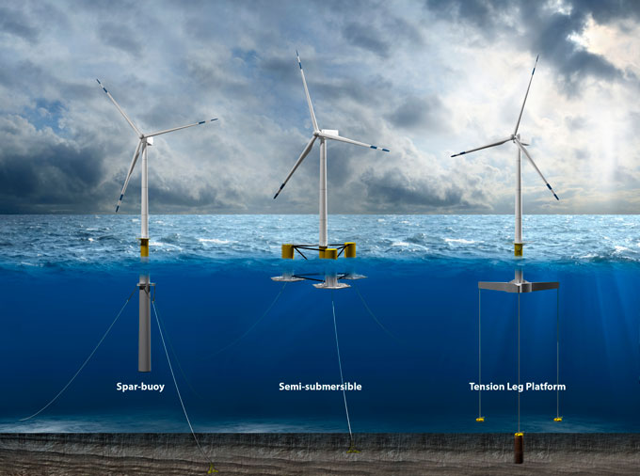
OFWT Concepts
Figure Credit: Illustration by Joshua Bauer, NREL

Slide 7
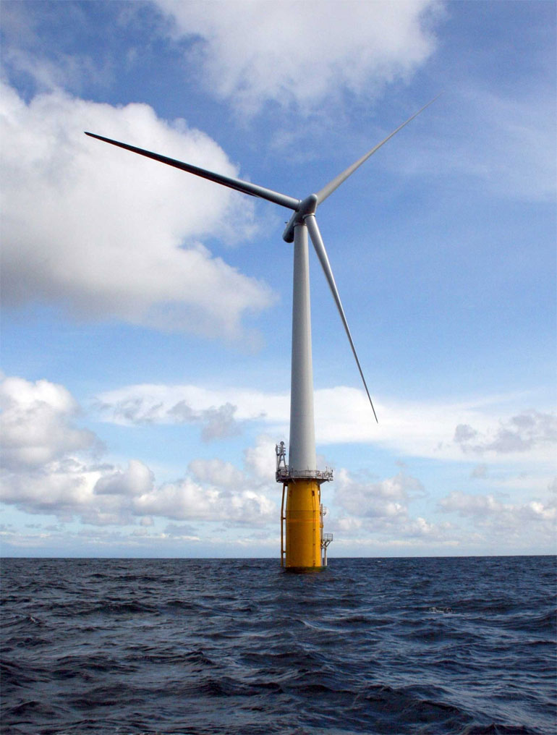
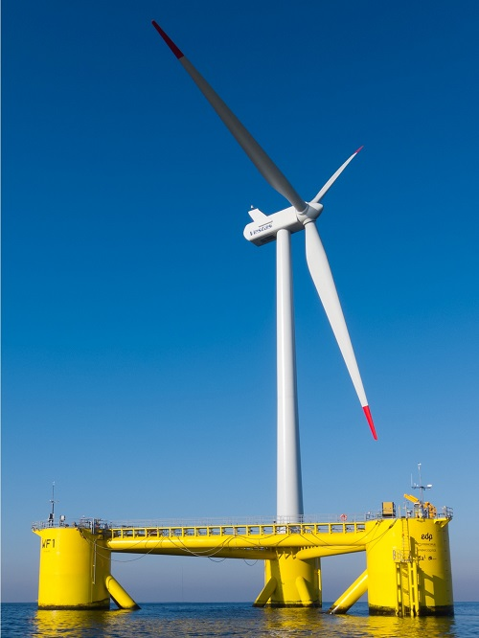
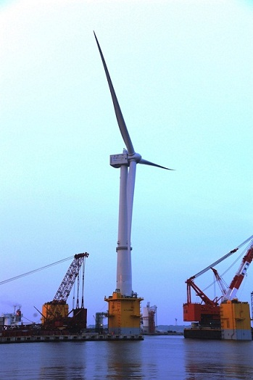
Full-scale OFWTs
(a) Hywind floating wind turbine
(b) WindFloat floating wind
(c) The Mistubishi 7MW
floating turbine

Slide 8
Aerodynamic Models
Blade element momentum theory
Computational fluid dynamics
Potential flow methods
Prescribed vortex method
Free vortex method
Panel Method
(a) BEM
(b) CFD
Figure Credit:
http://fluidsengineering.asmedigitalcollection.asme.org/article.aspx?articleid=1439572
http://www.windpowerengineering.com/construction/simulation/simulating-the-turbine-simulating-the-site

Slide 9
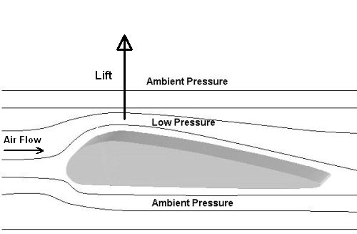
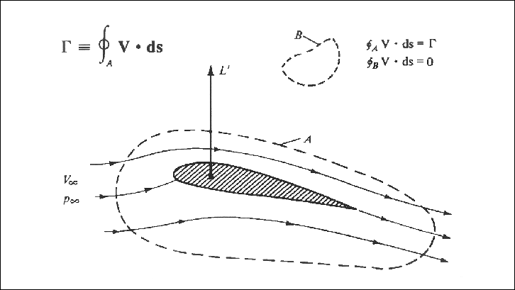
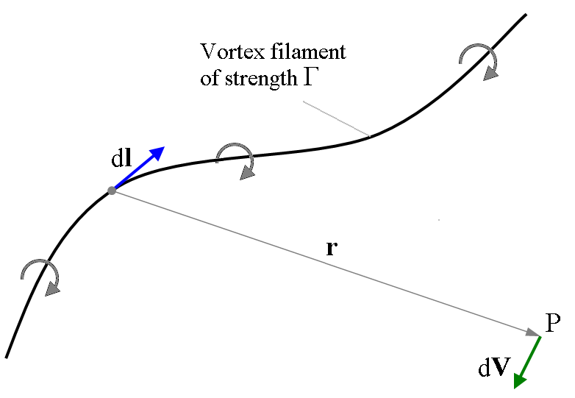
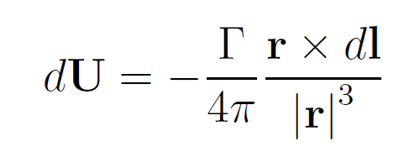
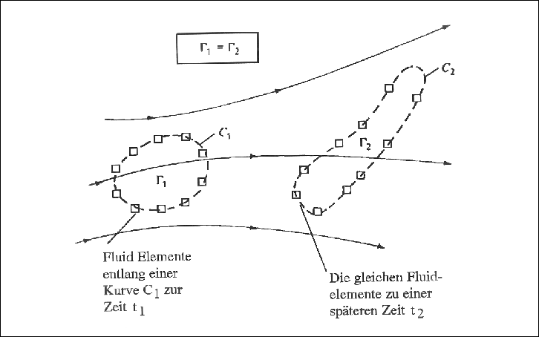
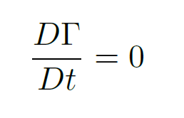
Free Vortex Method (2D)
Iteration to get Cl
Kutta–Joukowski theorem
Biot-Savart Law
Calculate lifting force
Kelvin’s circulation theorem

Slide 10
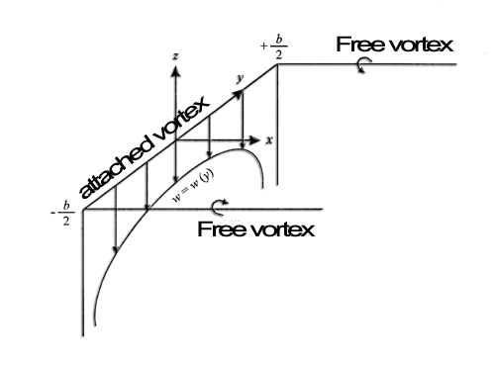
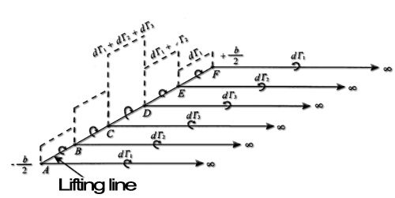
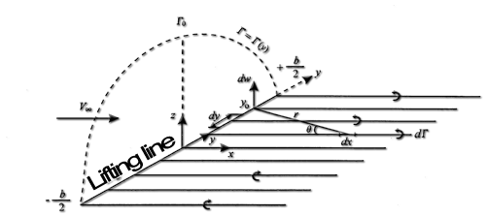
Free Vortex Method (3D)
Prandtl lifting-line theory
(a) Single vortex
(b) Superimposed vortices
(c) Infinite number of vortices
Figure Credit:
http://ggrot323.weebly.com/waterfowl.html
http://heli-air.net/2016/02/25/the-kutta-joukowski-theorem-and-the-generation-of-lift/
https://en.wikipedia.org/wiki/Biot%E2%80%93Savart_law
http://heli-air.net/2016/02/25/kelvin-s-circulation-theorem-and-the-starting-vortex/
http://www.heliciel.com/en/helice/calcul-helice-aile/Theorie-%20ligne%20portante-Prandtl.htm

Slide 11
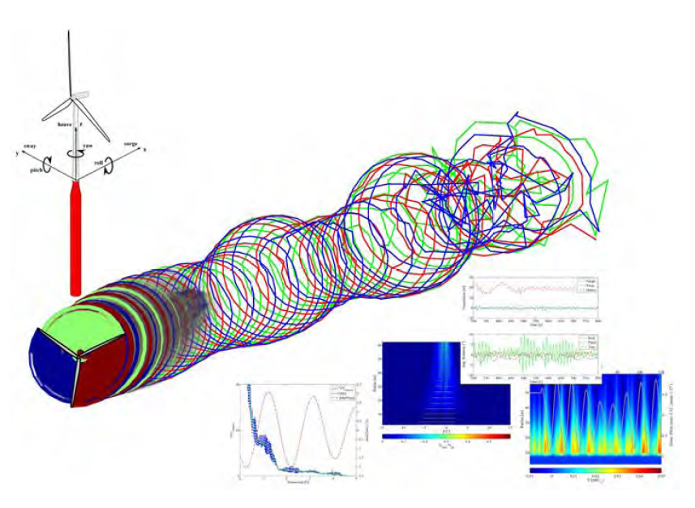
Wake Induced Dynamics Simulator (WInDS)
Written by Sebastian and Lackner at Umass-Amherst
Lifting line theory (LLT) -based free vortex wake method (FVM)
Modeling the offshore floating wind turbine(OFWT) aerodynamics to a higher degree of accuracy than is possible via momentum balance methods.
WInDS natively incorporates the multiple DOFs present in offshore floating wind turbines
Figure Credit: Thomas Sebastian

Slide 12
Pros and Cons of WInDS
Pros:
Inherent aerodynamic flexibility as compared to BEM.
Second order accuracy.
Core modeling.
Ground effects by deVelder and dynamic stall by Gaertner.
Cons
Structural positions and velocities are computed a priori and as such, cannot react to the aerodynamic loading or structural dynamics.
Written in MATLAB and the O(N²) calculation is very slow.
Focus of this dissertation
Reference: Nathaniel B. deVelder’s thesis

Slide 13
Outline
Background
Offshore Floating Wind Turbine
Aerodynamic Models
Free Vortex Method
WInDS
Acceleration of WInDS
Coupling WInDS with FAST/AeroDyn
Compiling on MGPHCC
Results
Near-Term Goals
Concluding Remarks

Slide 14
Approaches to Biot-Savart Law
Device: GPU vs CPU
Algorithm: Treecode vs Fast Multipole Method
Figure Credit:
http://www.bu.edu/exafmm
http://www.nvidia.com/object/what-is-gpu-computing.html

Slide 15
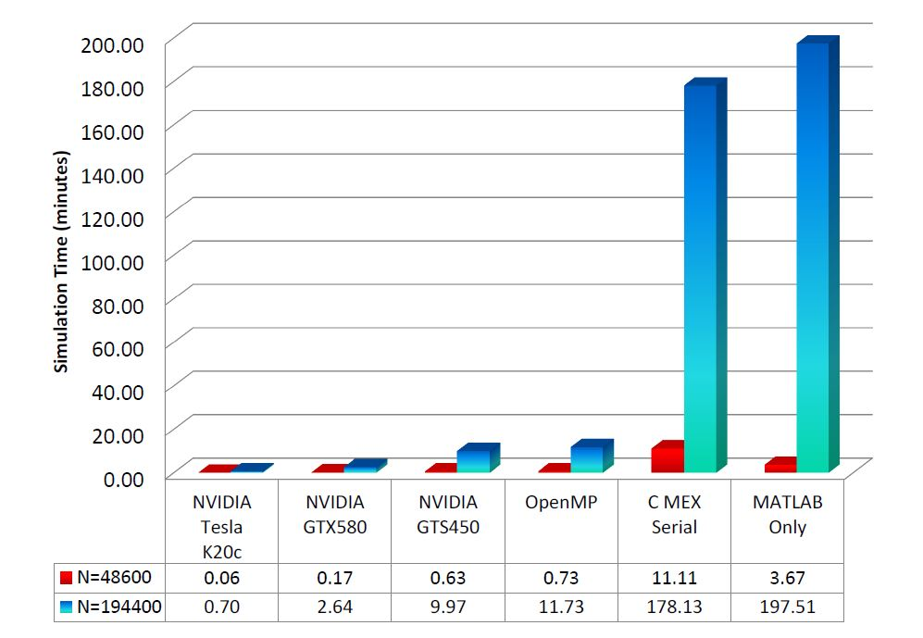
Previous Research
Results from Nathaniel B. deVelder’s thesis

Slide 16
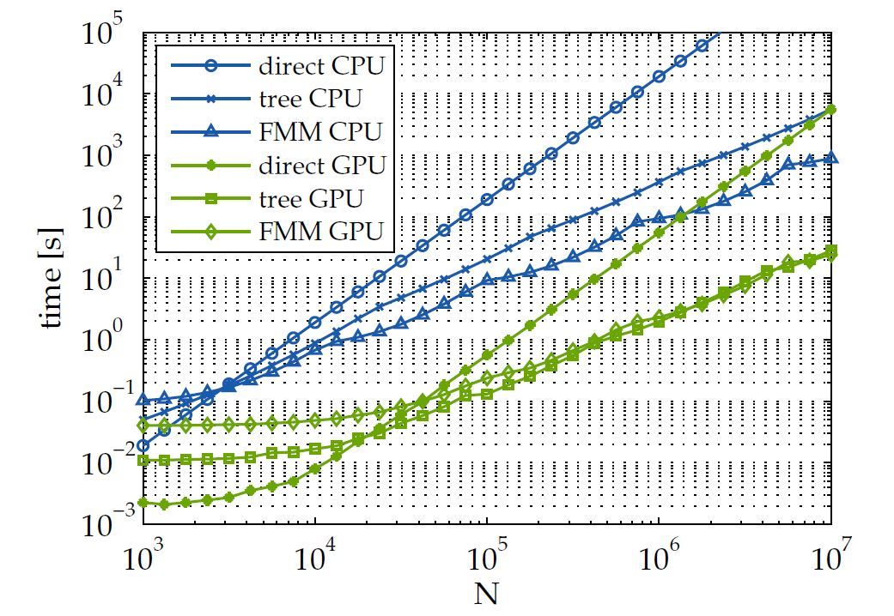
Comparison of Performance
Thomas Sebastian
This dissertation
Nathaniel B. deVelder
This dissertation
Comparison of algorithms. Yokota, R., & Barba, L. A. (2011)

Slide 17
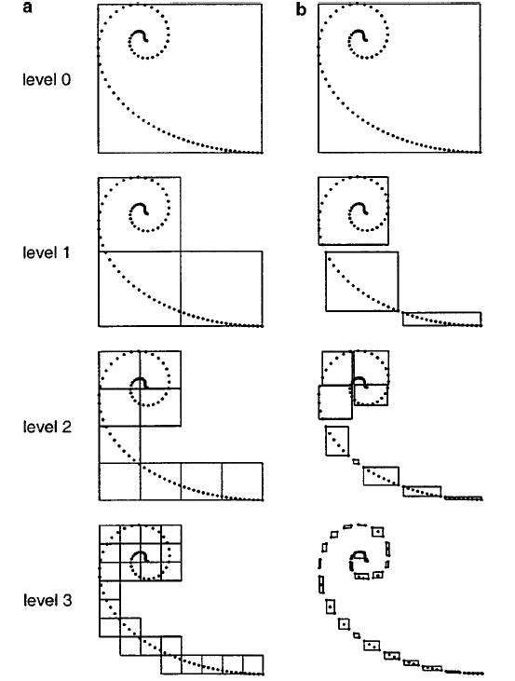
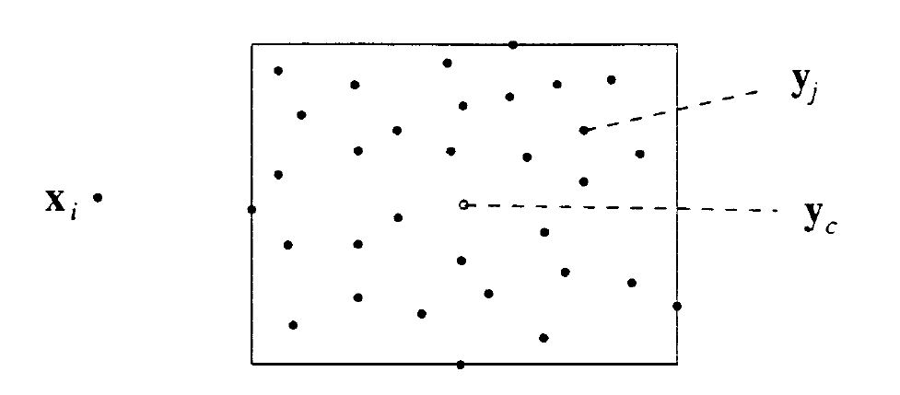
Treecode Algorithm
Figure: Treecode Algorithm
Lindsay, K., & Krasny, R. (2001)

Slide 18
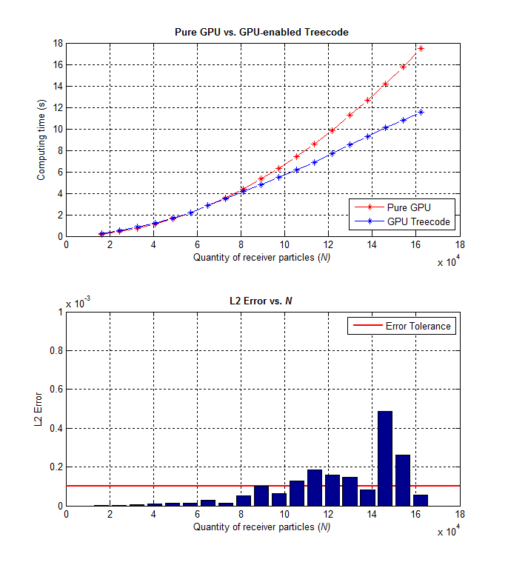
Parallelized Treecode in CUDA
(a) Running time
(c) Time of each part
(b) Error

Slide 19
Parallelized Treecode in Fortran
(a) Running time
(b) Speedup
(c) L2 norm error
(d) Running time in Log-log scale plot

Slide 20
Parallelized Treecode in Fortran
(a) Relative error of rotor speed
(b) Relative error of rotor torque
(c) Relative error of generated power
(d) Relative error of blade pitch angle

Slide 21
Outline
Background
Offshore Floating Wind Turbine
Aerodynamic Models
Free Vortex Method
WInDS
Acceleration of WInDS
Coupling WInDS with FAST/AeroDyn
Compiling on MGPHCC
Results
Near-Term Goals
Concluding Remarks

Slide 22
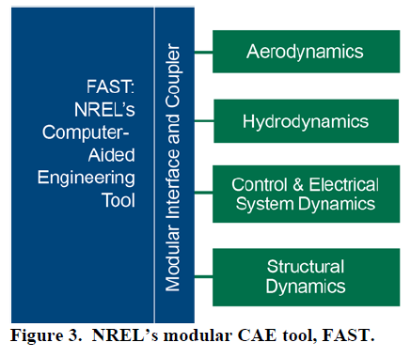
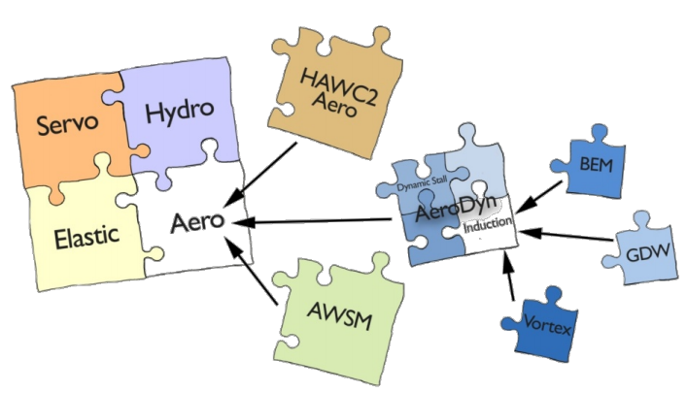
New Framework of FAST
New framework of FAST support
WInDS is integrated into AeroDyn
Figure Credit: NREL

Slide 23
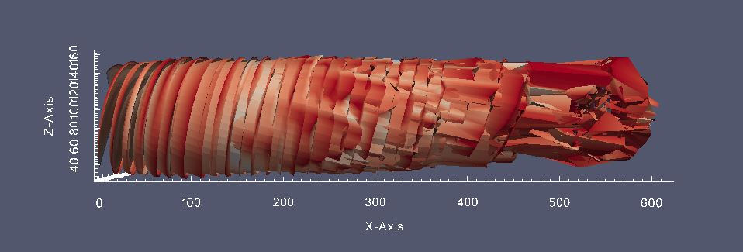
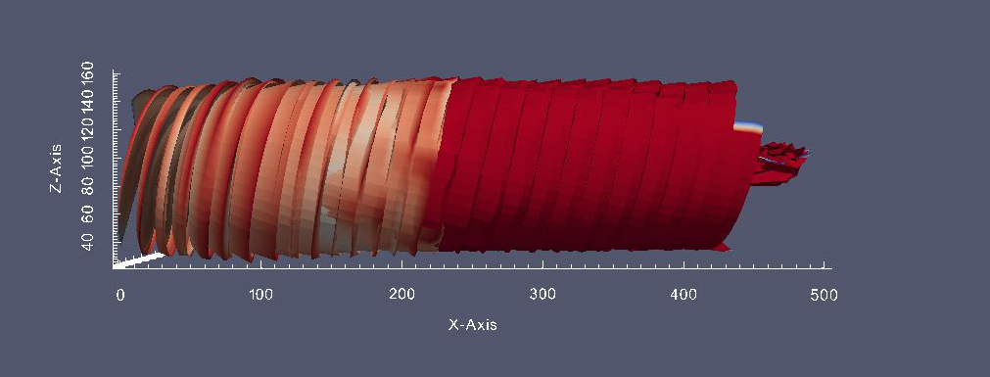
Far Wake Approximation
Full wake vs far wake approximation

Slide 24
Comparison of Computation Approaches
(a) Comparison of running time
(b) Comparison of max memory
(c) Comparison of running in log scale
(d) Comparison of running time by two computation approaches

Slide 25
Results
Simulations of on NREL 5-MW offshore turbine + OC3 Hywind platform
Outputs are generated power
Applied parallelized Treecode Algorithm and far wake approximation
Run on Massachusetts Green High Performance Computing Center (MGHPCC)

Slide 26
Below Rated Inflow

Slide 27
Below Rated Inflow

Slide 28
Rated Inflow

Slide 29
Rated Inflow

Slide 30
Above Rated Inflow

Slide 31
Above Rated Inflow

Slide 32
Outline
Background
Offshore Floating Wind Turbine
Aerodynamic Models
Free Vortex Method
WInDS
Acceleration of WInDS
Coupling WInDS with FAST/AeroDyn
Compiling on MGPHCC
Results
Near-Term Goals
Concluding Remarks

Slide 33
Near-Term Goals
Run more simulations under different wave and wind conditions.
Quantitatively analyze the influence of elasticity of floating wind turbine on unsteadiness of aerodynamics.
Provide suggestions for OFWT design.
Prepare for journal publication.
Finish dissertation.

Slide 34
Concluding Remarks
Parallelized Treecode Algorithm has been used to speedup WInDS.
WInDS has been re-written in Fortran and integrated with FAST to enable full aero-hydro-servo-elastic simulations.
FAST/WInDS has been compiled in Linux for super-computing.
WInDS has been shown to be more sensitive to the wave-driven platform motions than BEMT and have a higher level of accuracy.

Slide 35
References
Anderson Jr, John David. Fundamentals of aerodynamics. Tata McGraw-Hill Education, 2010.
DeVelder, Nathaniel B. Free wake potential flow vortex wind turbine modeling: Advances in parallel processing and integration of ground effects.
Jonkman, Jason M. The new modularization framework for the FAST wind turbine CAE tool. In 51st AIAA Aerospace Sciences Meeting and 31st ASME Wind Energy Symposium.
Leishman, Gordon J. Principles of helicopter aerodynamics with CD extra. Cambridge university press, 2006.
Lindsay, Keith. A three-dimensional cartesian tree-code and applications to vortex sheet roll-up. PhD thesis, The University of Michigan, 1997.
Lindsay, Keith, and Krasny, Robert. A particle method and adaptive treecode for vortex sheet motion in three-dimensional flow. Journal of Computational Physics 172, 2 (2001), 879–907.
Manwell, James F, McGowan, Jon G, and Rogers, Anthony L. Wind Energy Explained. Wiley Online Library, 2006.
Sebastian, T, and Lackner, MA. Development of a free vortex wake method code for offshore floating wind turbines. Renewable Energy 46 (2012), 269–275.
Sebastian, Thomas. The Aerodynamics and Near Wake of an Offshore Floating Horizontal Axis Wind Turbine. PhD thesis, University of Massachusetts Amherst, 2012.
Sebastian, Thomas, and Lackner, Matthew. A comparison of first-order aero- dynamic analysis methods for floating wind turbines. In 48th AIAA Aerospace Sciences Meeting, Orlando, Florida (2010).
Yokota, Rio, and Barba, Lorena A. Treecode and fast multipole method for N- body simulation with CUDA. GPU Computing Gems Emerald Edition (2011), 113.

Slide 36
Questions?

